Slide 1



NLP-Based Phishing Email Detection
Using Machine Learning and NLP Techniques
By Soumya.A, Soundarya Devi.k, Sivaharini.S , Naviya Sree.S

Slide 2
Abstract
This project focuses on the development of a machine learning-based email classification system to detect spam messages using the Enron email dataset.
By leveraging natural language processing (NLP) techniques and logistic regression, the system can effectively differentiate between spam and legitimate emails.
To improve the model's accuracy and robustness, additional features like link count, uppercase usage, special character count, email length, and word count have been introduced alongside traditional TF-IDF text vectorization.
This enhanced approach increases reliability in identifying spam patterns beyond textual content, offering a practical solution for email filtering and user protection against unsolicited or malicious messages.

Slide 3
Introduction
Spam emails pose significant risks, including phishing, malware, and identity theft, leading to financial and reputational damage while cluttering inboxes.
Traditional spam detection methods like blacklists and rule-based filtering are insufficient against the evolving tactics of spammers.
Machine learning algorithms analyze various email components, such as the subject line, body text, sender’s address, and metadata, to identify patterns distinguishing spam from legitimate emails.
The model uses NLP to clean and process email content, and machine learning techniques to classify emails as either spam or not spam.
The project aims to develop an effective spam email detection system using machine learning, ensuring accurate classification and minimizing false positives for a safer email experience.

Slide 4
Technologies Used
ML Algorithms: Naive Bayes, SVM, Decision Trees
NLP Techniques: Tokenization, POS tagging, NER
Tools: Scikit-learn, NLTK, SpaCy, TensorFlow, PyTorch
Deployment: Flask/Django, Docker, Cloud Platforms

Slide 5
Project Implementation
1. Problem Definition
The goal of this project is to develop a system that can automatically detect and classify emails as spam (unwanted emails) or ham (legitimate emails).
2. Data Collection
Dataset:
The data set which is used here is Enron Spam Dataset, which contains labeled examples of spam and non-spam emails or messages.
Each entry in the dataset has a label (e.g., spam or ham) and the message content.
Data Format:
Typically, the dataset consists of three columns:
Label: Indicates if the email is spam or ham.
Message: The text content of the email or message.
Subject: The content in the subject place of the mail

Slide 6
3.Data Preprocessing
Data preprocessing is critical for transforming raw text into a format that can be used by machine learning models.
Text Cleaning:
Remove unnecessary characters such as punctuation marks, special characters, and numbers.
Convert all text to lowercase to ensure consistency.
Remove common stopwords (e.g., "and," "the," "is") that don’t provide meaningful information for classification.
Tokenization:
Split the text into individual words or tokens. This helps the system analyze the frequency of each word.
Stemming or Lemmatization:
Reduce words to their base forms (e.g., "running" becomes "run"). This step helps reduce dimensionality and noise.

Slide 7
4. Feature Extraction
After cleaning the text, we need to convert the text data into numerical form so machine learning algorithms can process it.
Bag of Words (BoW): user to rerpresent email in vector or frequency form
TF-IDF (Term Frequency-Inverse Document Frequency): it evaluates the importance of word in the email
5. Model Selection
We have model like Naïve Bayes, SVM, Random Forest and more but here we used Logistic regression for binary classification like spam or not
6. Model Training
The chosen model is trained using the preprocessed data. In this stage, the model learns the patterns that distinguish spam from ham emails.
Training the Model:
Split the dataset into two parts: a training set (used to train the model) and a test set (used to evaluate the model)

Slide 8
7. Model Evaluation
Accuracy: Measures the proportion of correct classifications (spam and ham) out of all predictions.
Confusion Matrix: A table that shows the true positives (spam correctly classified as spam), false positives (ham incorrectly classified as spam), true negatives (ham correctly classified as ham), and false negatives (spam incorrectly classified as ham).
Precision, Recall, and F1-Score:
Precision: The proportion of true positive spam emails out of all emails classified as spam.
Recall: The proportion of true positive spam emails out of all actual spam emails.
F1-Score: The harmonic mean of precision and recall, providing a balance between the two.

Slide 9
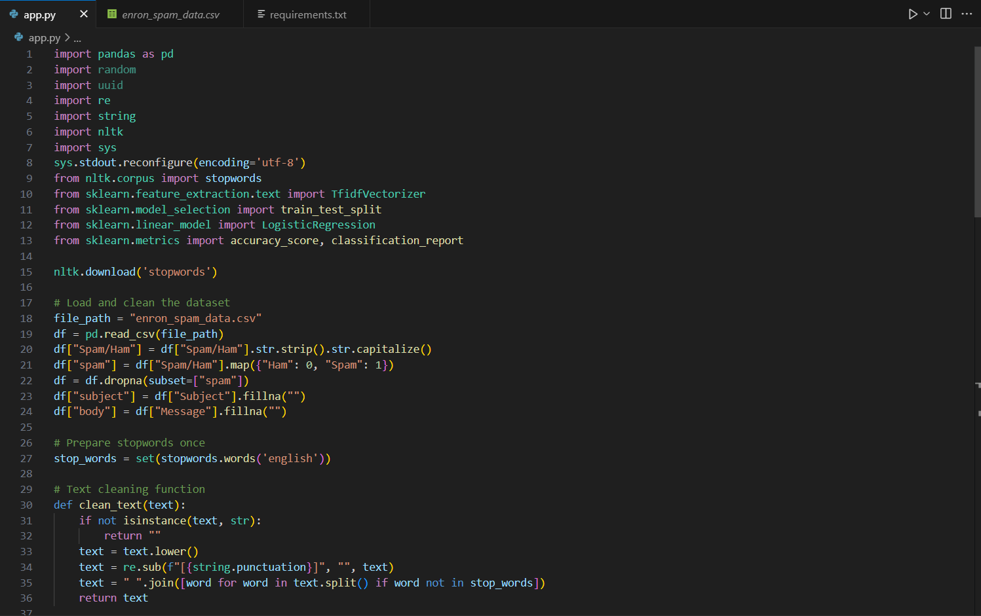
Code

Slide 10
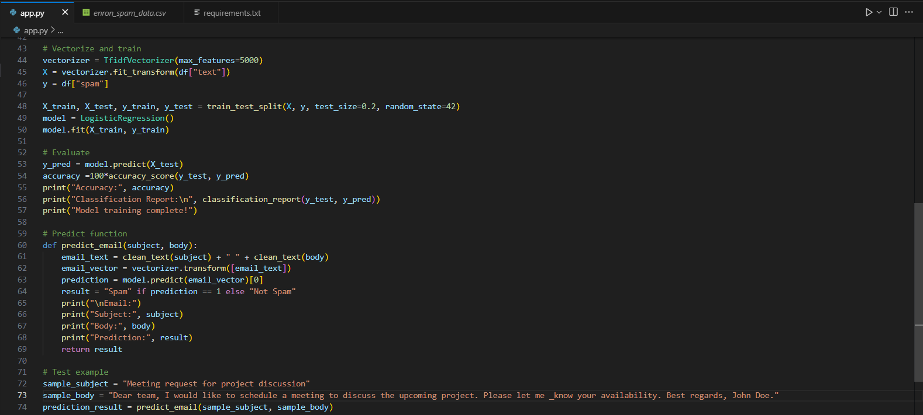

Slide 11
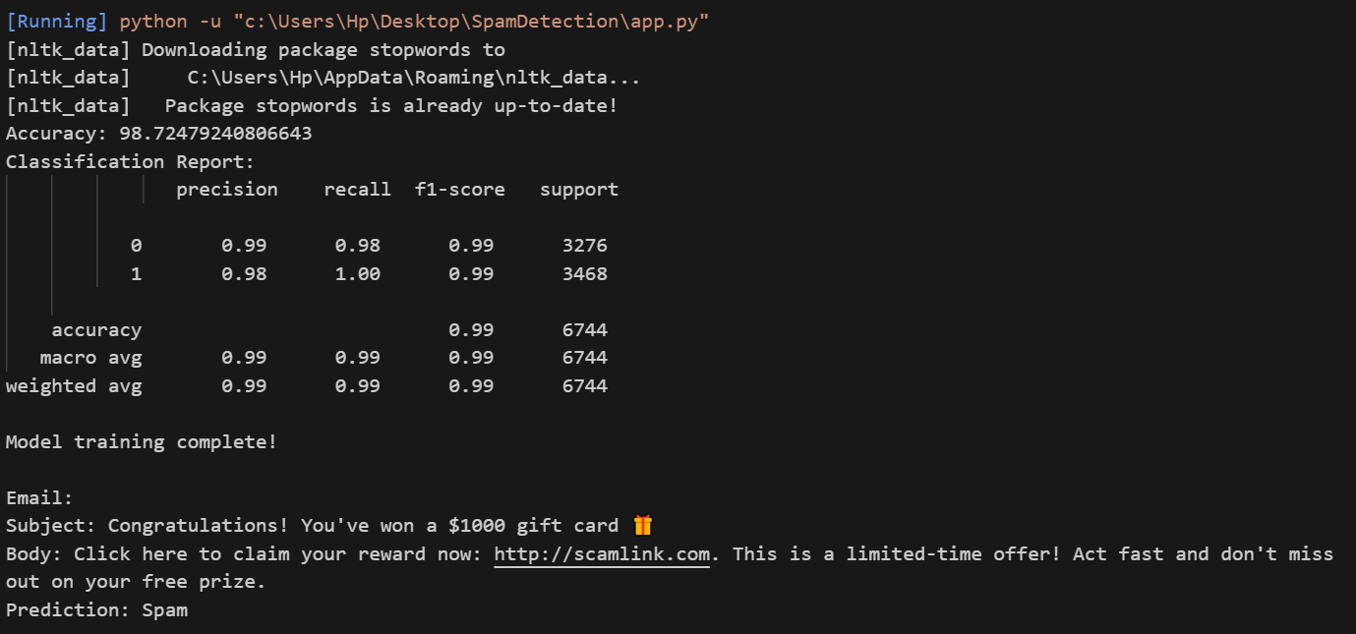
Sample Output 1

Slide 12
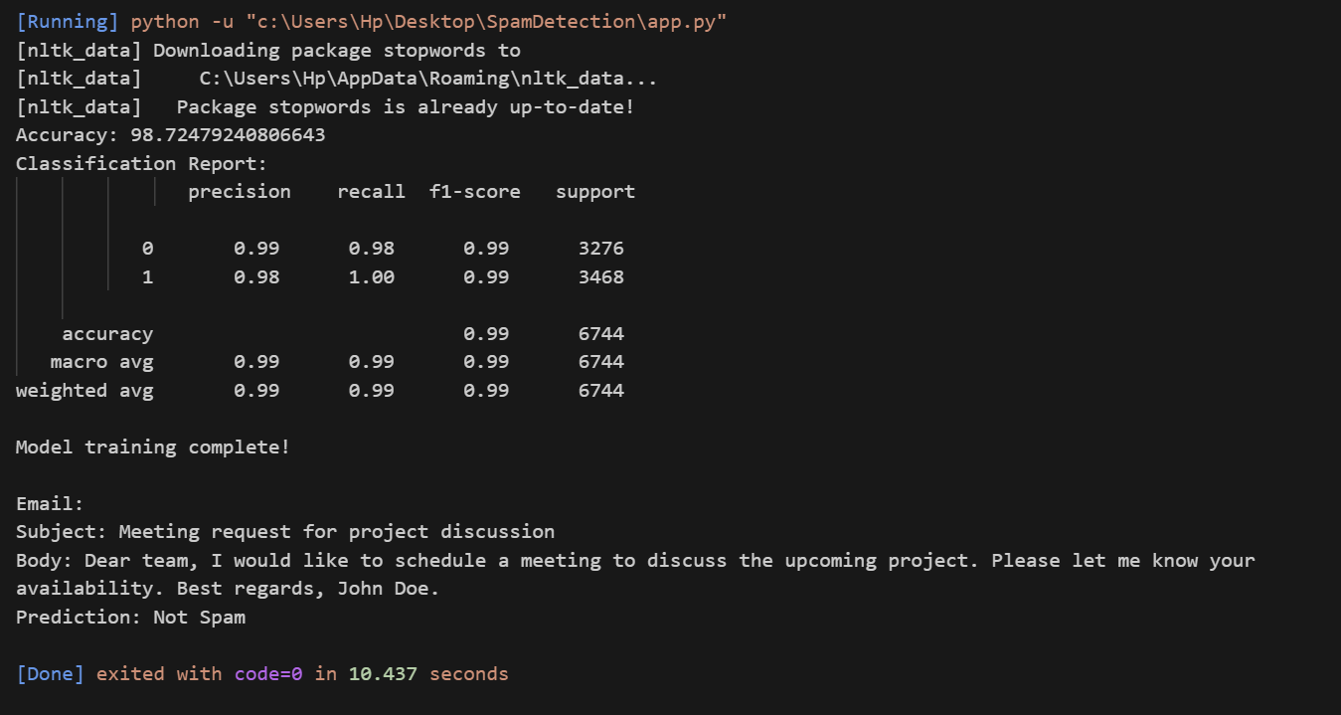
Sample Output 2

Slide 13
Conclusion
This project demonstrates an effective spam detection system using machine learning and natural language processing.
TF-IDF and Logistic Regression accurately classifies emails as spam or not.
98% accuracy achieved using logistic regression.
Future work: use deep learning (BERT, LSTM), better datasets, support real-time deployment.

